Slide 1
The 7 Dwarves & 7 Neurotransmitters
Ricque Brister MD

Slide 2
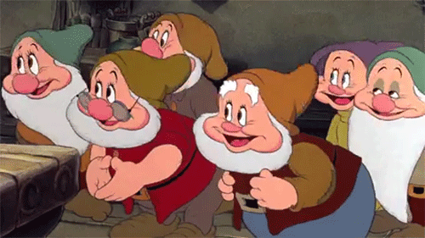
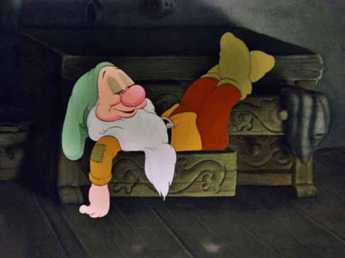
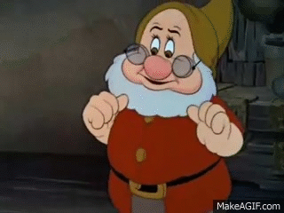
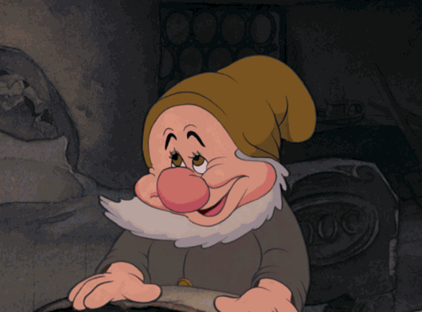
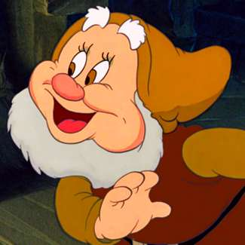
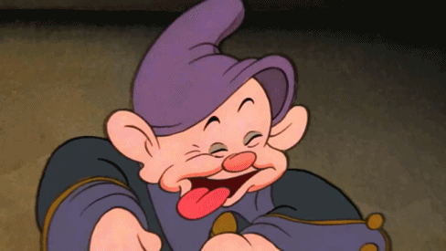
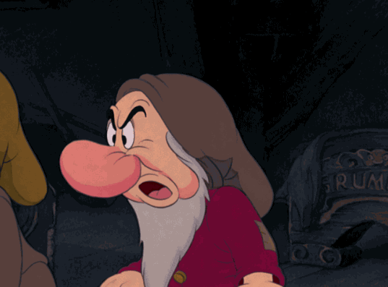
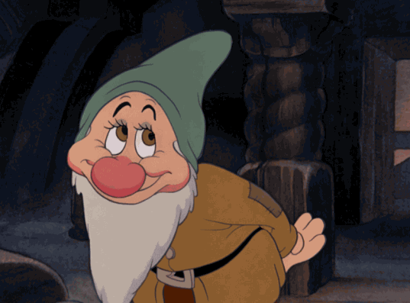
7 new patients
Sneezy
Sleepy
Grumpy
Bashful
Happy
Dopey
Doc

Slide 3
A Brief Introduction

Slide 4
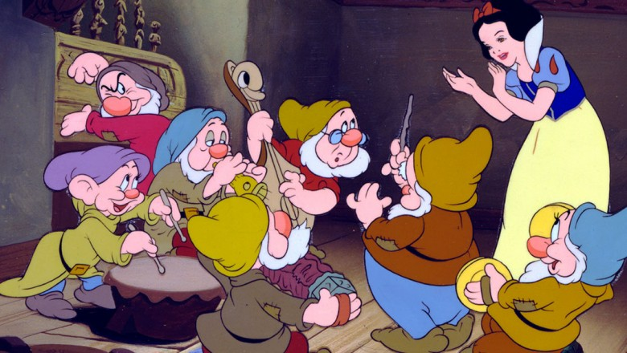
7 Neurotransmitters
Norepinephrine – Arousal, Learning, Mood
Seretonin – Sleep, Mood, Eating
GABA – Inhibitory of all neuronal firing
Glutamate – Excitatory of all neuronal firing
Dopamine – Movement, Pleasure
Acetylcholine – Muscle, Digestion, Memory
Endorphins – Pain, Pleasure

Slide 5
Medications to adjust neurotransmission
1. Seretonin
– SSRIs (meds w/ Xs and Zs in the name)
Prozac, Lexapro
– TCA (amitrytaline)
– Antipsychotics
Risperdal, Zyprexa, Geodon, Abilify, (surprisingly) older neuroleptics, Thorazine, etc.
2. Norepinephrine
– Welbutrin
– TCA (Desipramine)
Combination
Seretonin Norepinephrine meds:
– TCA (Imipramine), Effexor, Cymbalta

Slide 6
Medications to adjust neurotransmission cont.
3. Dopamine
– Antipsychotics (old and new)
Thorazine –> Abilify
4. GABA
– Benzos, Gabapentin, Buspar
5. Acetylcholine
– Acetylcholinesterase drugs
6. Endorphins
– Opiates & Opiate blockers
Naloxone
7. Glutamate
– Anti-dementia drugs
– Anti-cholinesterase drugs
Aricept, Galantamine, Exelon

Slide 7
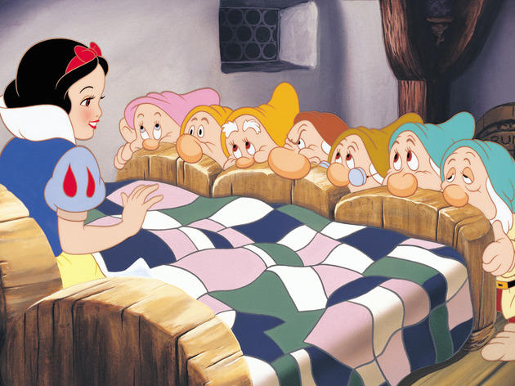
Treatment plans for 7 dwarfs
Pharmacologic
Sneezy – Antihistamine
Sleepy – Seretonin
Grumpy – Seretonin
Bashful – GABA
Happy – Naltrexone
Dopey – Antipsychotic & Acetylcholine
Doc – Seretonin, possible dopamine for TICs

Slide 8
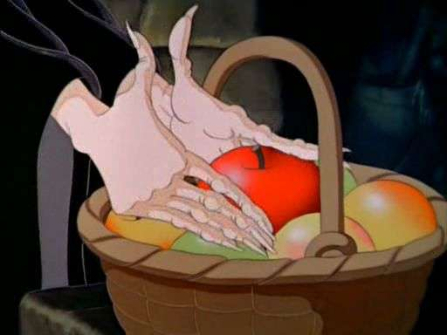
Treatment plans for 7 dwarfs cont.
B. Lifestyle changes
Exercise
No white flour, no sugar (Ketogenic)
Sunshine
Mindfulness – Meditation, Yoga
Journaling
Gratitude
Decreasing Cortisol
Probiotics, Prebiotics, Ashwaganda, Growth Hormone

Slide 9
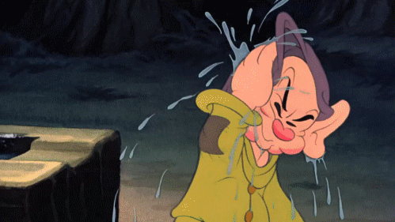
Review, Post-test & Questions
Norepinephrine – Arousal, Learning, Mood
Seretonin – Sleep, Mood, Eating
GABA – Inhibitory of all neuronal firing
Glutamate – Excitatory of all neuronal firing
Dopamine – Movement, Pleasure
Acetylcholine – Muscle, Digestion, Memory
Endorphins – Pain, Pleasure

Slide 10
Heigh-Ho!

